Slide 1
Wrangling Reproducibility in your Research with Nextflow, Conda, and Docker
2024/10/24
Guppy Stott (they/them/theirs)

Slide 2
Nextflow and Workflow Management

Slide 3
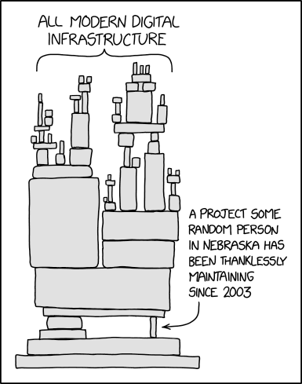
Why workflow management at all?
You won’t be at UGA forever
Research that isn’t reproducible isn’t worth doing
You want your research to be applied to new problems and questions
You’re lazy and don’t want to write a new bash script each time you do something new
You want to be able to manage batch processes and cache results

Slide 4
What is Nextflow?
Workflow management system
Portable and interoperable across local, cluster, and cloud environments
Enables reproducible analyses that can easily be repeated with new datasets
Easy parallelizability
Provides checkpointing of analyses at each step of a workflow

Slide 5
The two most popular workflow management systems: Nextflow and Snakemake
Nextflow
Groovy/Java-based
Allows passing of values between processes in addition to files
Caching of intermediate tasks
Jobs can be isolated with containers
Compatibility with most HPC and cloud infrastructure
Run by a VC firm
Snakemake
Python-based
Requires each input and output to be a file
Between workflow caching
Jobs can be isolated with containers
Limited compatibility with cloud infrastructure
Run by academics

Slide 6
Job Isolation with Containers and/or Conda

Slide 7
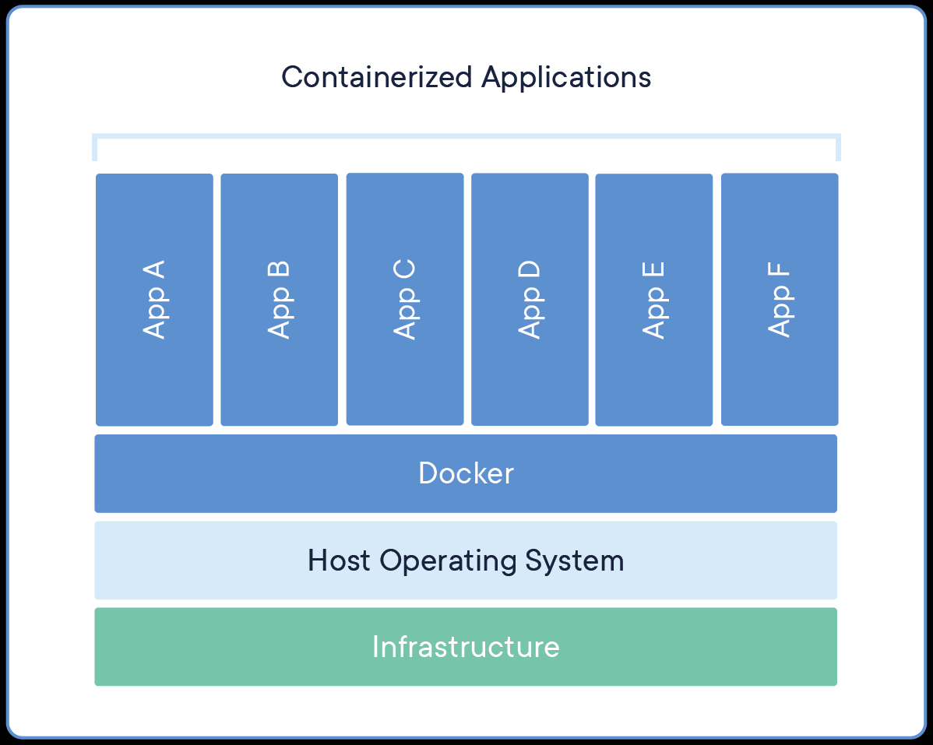
What’s a container?
Lightweight and standalone package of software
Containerized software runs the same way regardless of infrastructure
Isolates software from the environment
You can think of it like a lightweight virtual machine

Slide 8
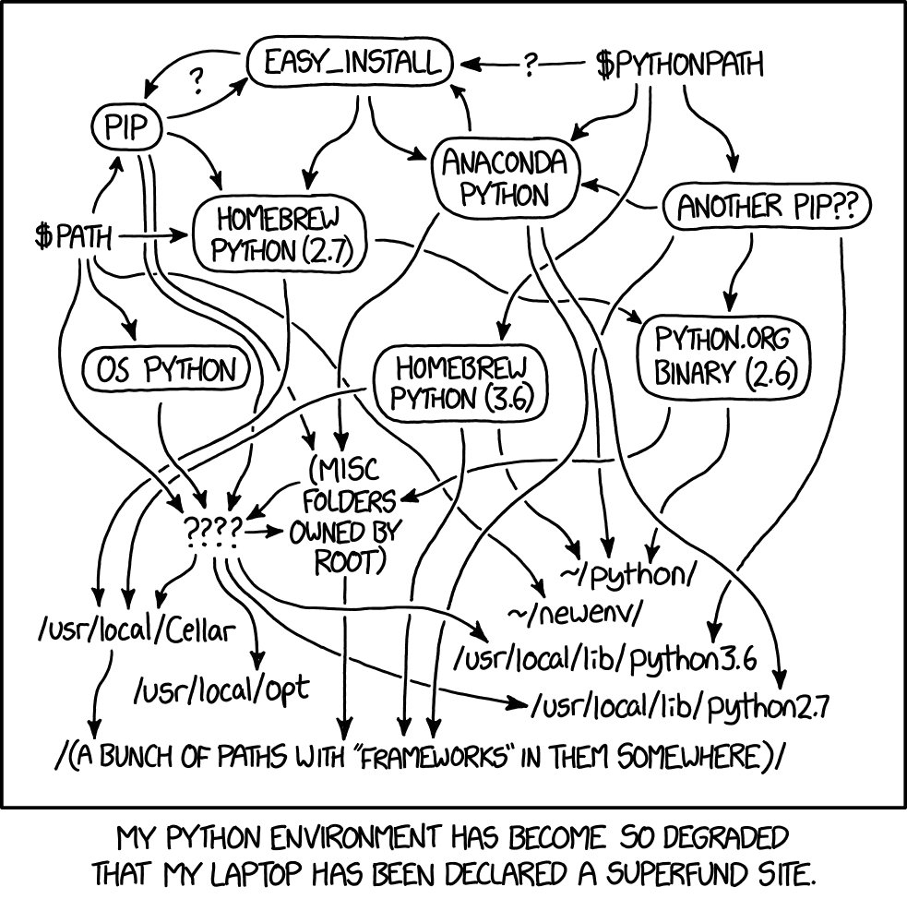
What’s a conda?
Package manager
Cross-platform and language-agnostic
Allows for creation of “environments” which isolate a set of packages for a given project/task

Slide 9
Which do I use?
Depends!
Are you working in R or Python and just need to install a few packages?
Are your packages/modules found on anaconda.org?
Does a container already exist on hub.docker.com?

Slide 10
Cool, I get it’s important, but how do I do this?

Slide 11
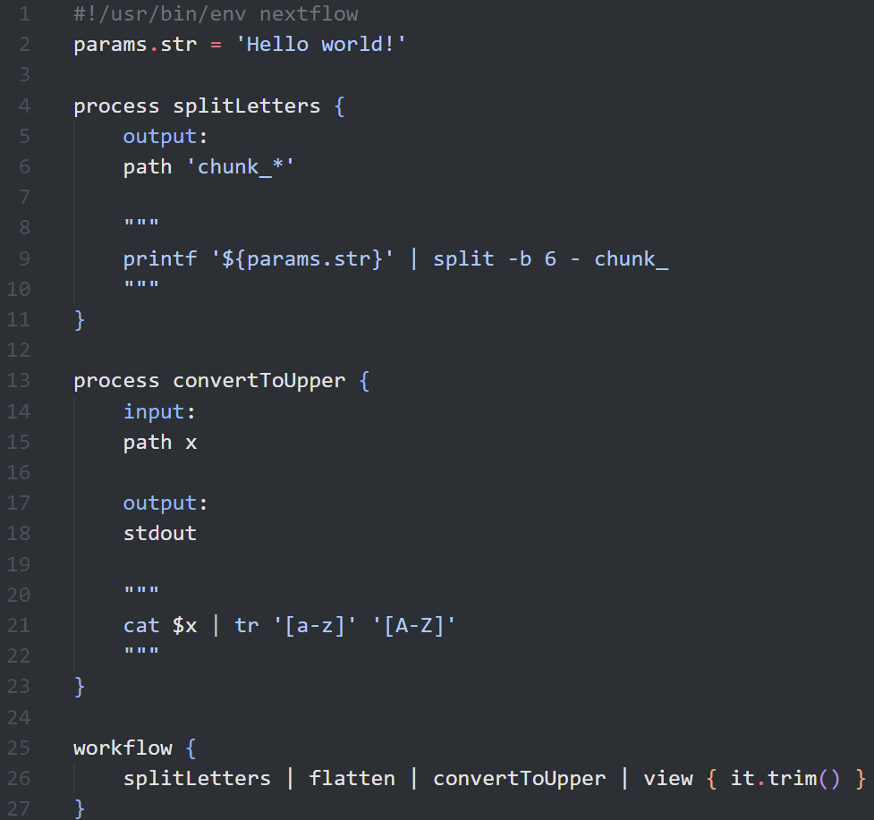
Components of a Nextflow pipeline
Channels: the data “stream”
Used to pass information between processes
Can be a single item or a collection of items
Can be values or files
Processes: the equivalent of functions
Can be written in any scripting language (e.g. bash, R, python)
3 components
Input
Output
Script
Workflows: the actual workflow being executed
At least one is needed for a Nextflow script
If you make multiple and they are named, you can execute different workflows independently

Slide 12
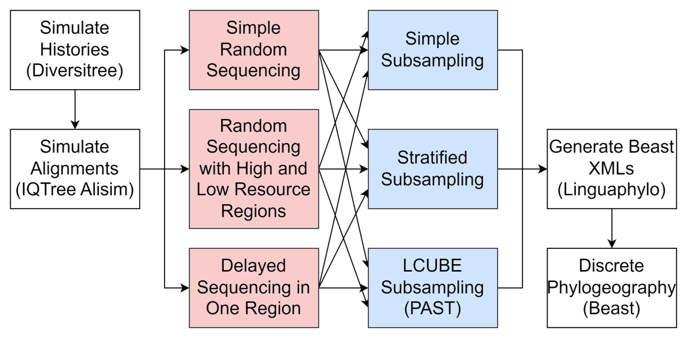
How do you start?
Create a diagram of your workflow
Build your workflow one process at a time
Test each component thoroughly

Slide 13

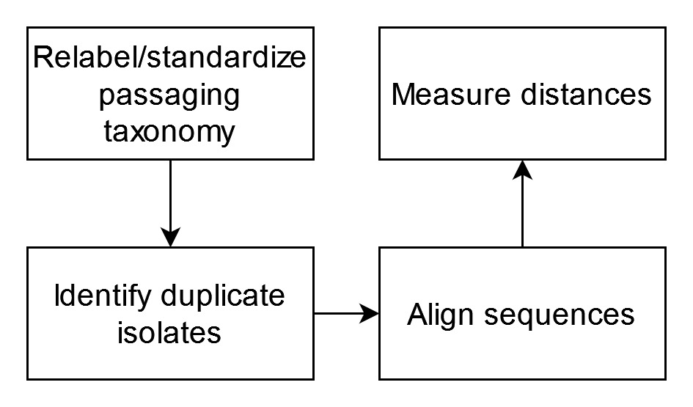
Example: Investigation into Passaging Histories’ Impact on Phylogenies
Victoria Cipollino
Clemson University
Influenza isolates often are passaged prior to sequencing
Passaging has been shown to lead to erroneous antiviral resistance signal
How do these induced mutations impact our phylogenetic trees?

Slide 14
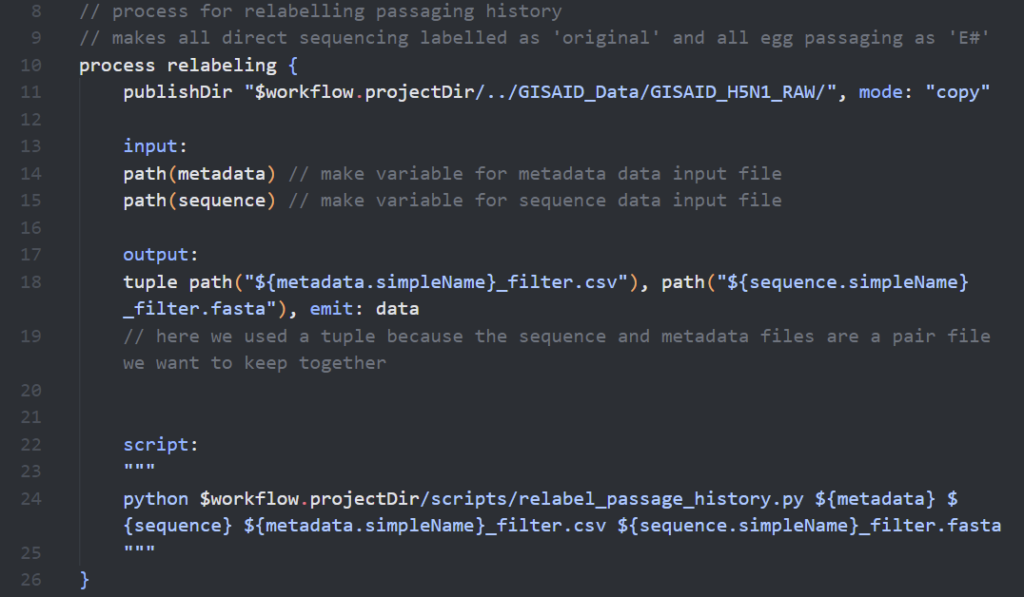
Relabel/standardize passaging taxonomy
Victoria Cipollino
Clemson University
Developed and tested a Python script for relabeling passage history
Python script separated from Nextflow to keep it legible

Slide 15
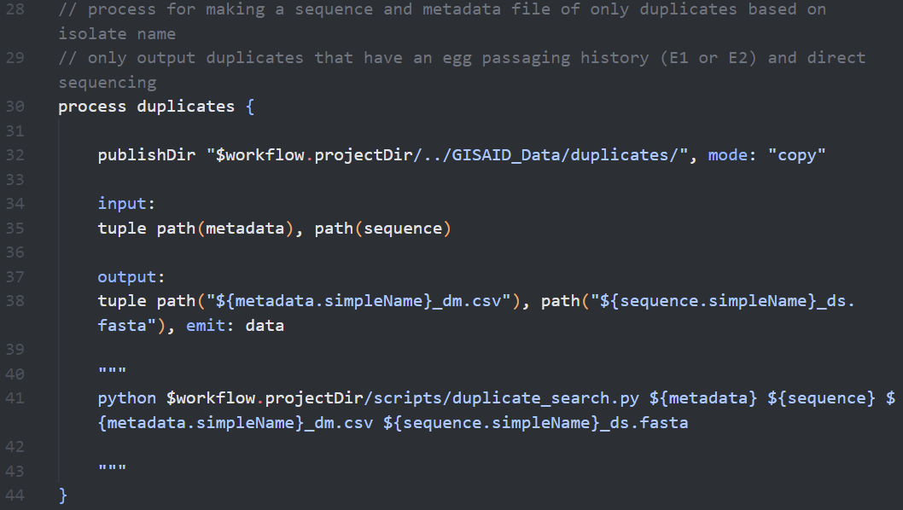
Identify duplicate isolates
Victoria Cipollino
Clemson University
Tested a script which identifies isolates that differ in just passaging history
Outputs a filtered metadata and sequence file

Slide 16
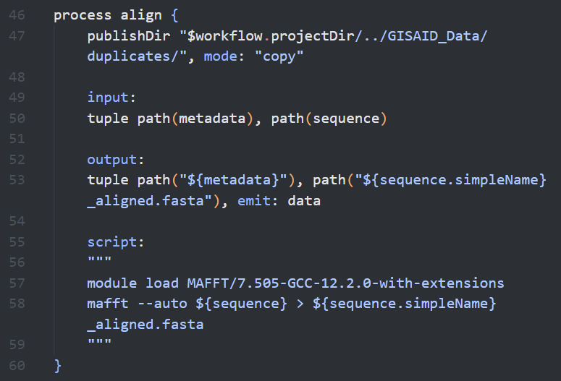
Align sequences
Victoria Cipollino
Clemson University
Alignment process uses module from cluster
Example using just tools in Bash

Slide 17
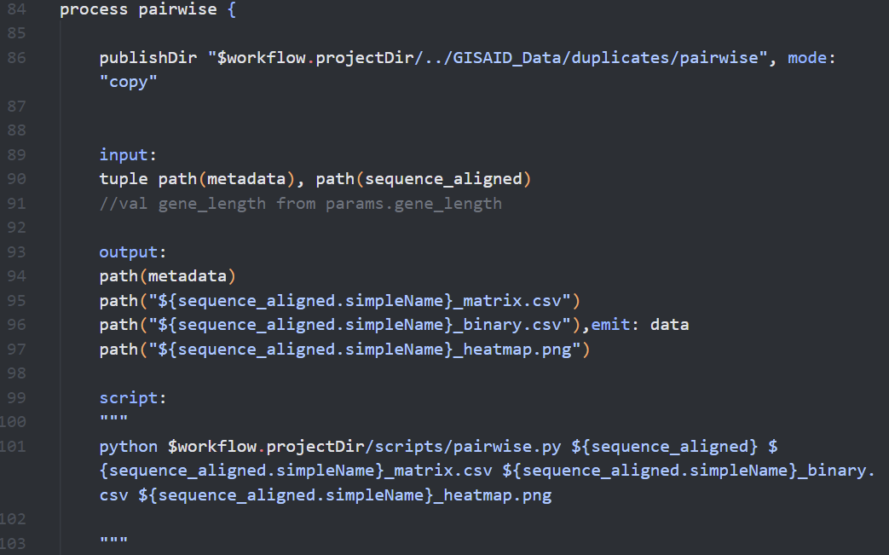
Measure distances
Victoria Cipollino
Clemson University
Another Python script is used to generate the analyses for her poster
This python script emits both raw data and a figure

Slide 18
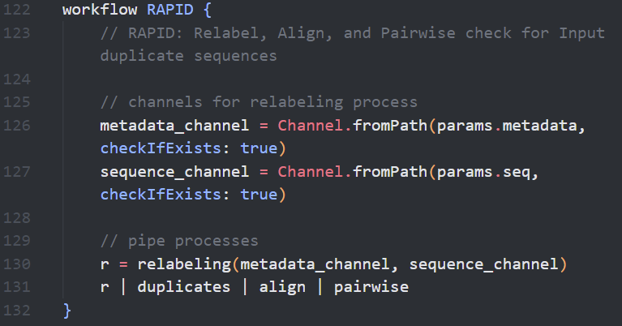
Bringing it all together
Victoria Cipollino
Clemson University
Uses channels to load in the data
Uses pipe notation to describe the workflow

Slide 19
How would we use HPC cluster options or leverage conda or Docker?

Slide 20
Reminder of “Align sequences”
Victoria Cipollino
Clemson University
Alignment process uses module from cluster
Example using just tools in Bash

Slide 21
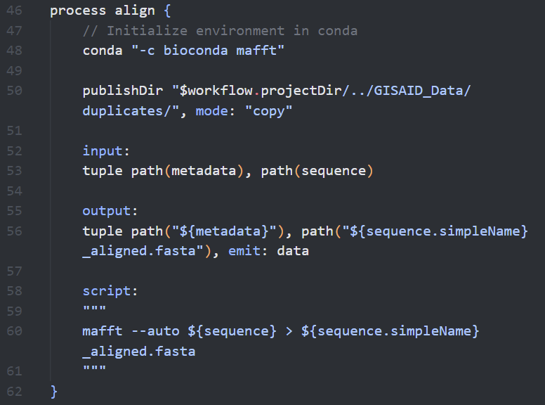
Align sequences (with Conda!)
Conda used instead of “Module Load” in cluster
Before running, added the line “ml Miniconda”
Works for packages/modules as well as software!

Slide 22
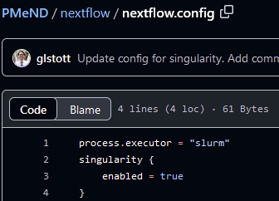
To add in cluster options, we need to modify our configuration options
Create a file, nextflow.config that specifies “slurm” as your executor
If you want to use docker, you need to do the same type of thing, enabling singularity

Slide 23
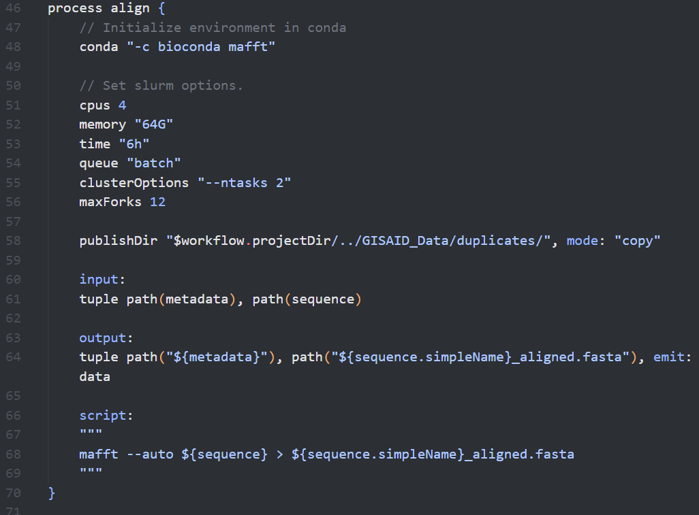
Adding in cluster options!
Can set any cluster option in the “clusterOptions” parameter as a string, like you would inline
Named parameters are listed in the documentation

Slide 24
Summary
Workflow management systems help you manage complex pipelines
Caching
Portability of pipelines
Docker and conda enable more reproducible
Limits need to manually manage dependencies
Ensures your work can be brought across platforms

Slide 25
Appendix

Slide 26
Example: Simulation Study to Optimize Subsampling in Bayesian Phylogeography
Bayesian Phylogeography often requires subsampling to reduce computation time
To test our novel subsampling method, we need to perform simulations of outbreaks

